Slide 1
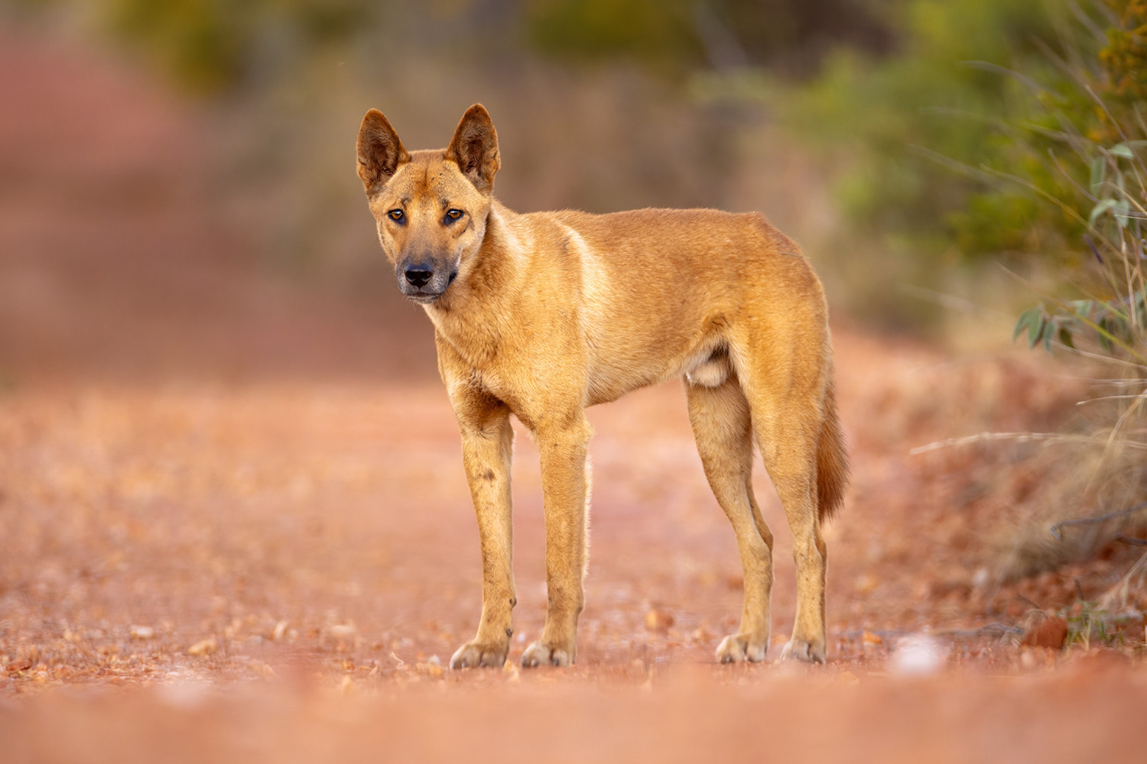

Movement ecology hackathon: A dingo case-study
Niraj Meisuria
Rhys Cairncross
Sally Burgemeestre
Thomas Newsome
Lily Bentley
Mitchell Cowan
Scott Forrest
Photo by Alexander Babych

Slide 2
Acknowledgement of Traditional Owners
Kaurna people as the Traditional Owner and Custodians of the Adelaide Plains.
Walpiri and Ngarti country where the data was collected.

Slide 3



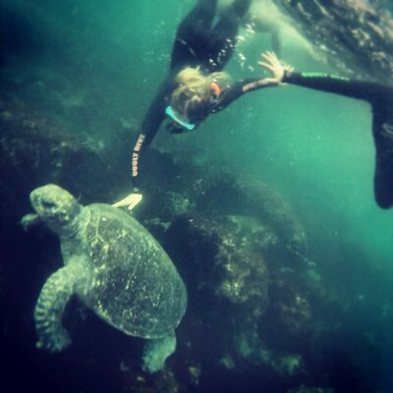
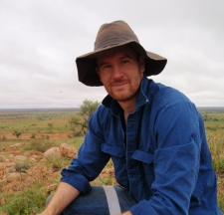


Organisers and facilitators
Members of the Movement Ecology Special Interest Network (MoveSIN)
Mitchell Cowan
Niraj Meisuria
Rhys Cairncross
Sally Burgemeestre
Thomas Newsome
Lily Bentley
Scott Forrest

Slide 4
Purpose of the workshop
Hackathon-style workshop
self-directed learning to tackle a research question of interest
small teams working independently
Hands-on experience with a new dataset
Thinking through a research question
Try out some different movement ecology methods

Slide 5
Time | Duration | Activity
9:00 am | 15 mins | Overview of workshop - introductions
9:15 am | 15 mins | Introduction to data and study system
09:30 am | 15 mins | Brainstorming possible research questions
09:45 am | 15 mins | Break into groups
10:00 am | 30 mins | Morning tea + coffee
10:30 am | 15 mins | Brief introduction to different movement ecology tools
10:45 am | 1 hour 15 mins | Working in groups
12:00 pm | 1 hour | Lunch
1:00 pm | 2 hours | Working in groups
3:00 pm | 15 mins | Afternoon tea
3:15 pm | 1 hour | Group presentations (5 mins each)
4:15 pm | 15 mins | Wrap-up
4:30 pm |  | Finish (post-workshop food/drink?)

Slide 6
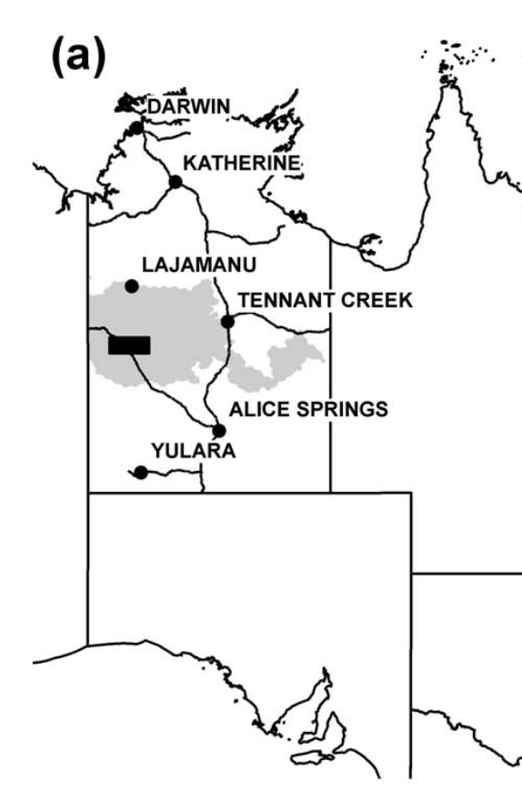
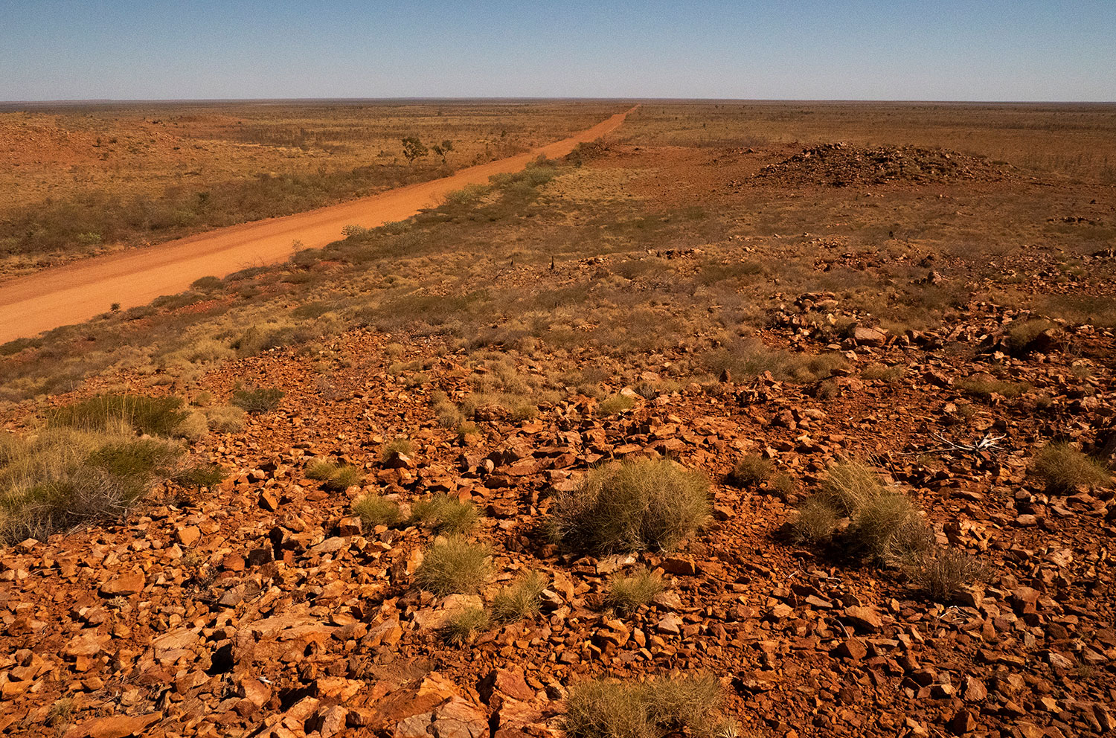
Study system - Tanami Desert
From Newsome et al. (2013)
Photo © John Lovett

Slide 7
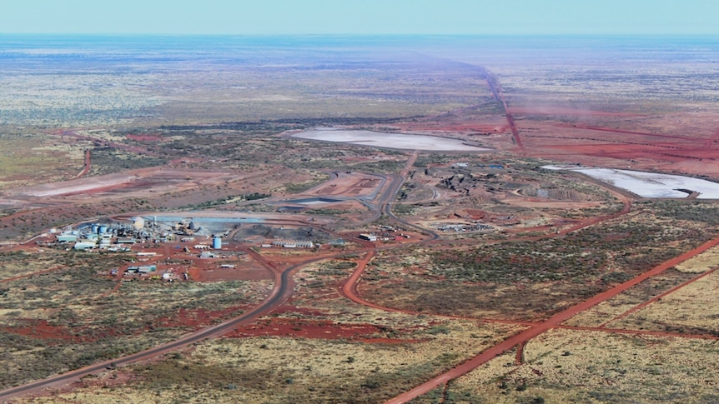
Tanami mine sites
Photo: Caddie Brain

Slide 8
Tanami mine sites
Mine sites
food resources are spatially clumped and very rich
increase interactions with humans and possibly each other
Spatially distant areas (non-mine sites)
food resources are naturally dispersed and relatively sparse

Slide 9
Dingo (Canis lupus dingo)
Dingoes introduced to Australia ~4,000 years ago, since naturalised
Australia’s top mammalian predator
Interact with humans through refuse and artificial water points
Photo by Alexander Babych

Slide 10
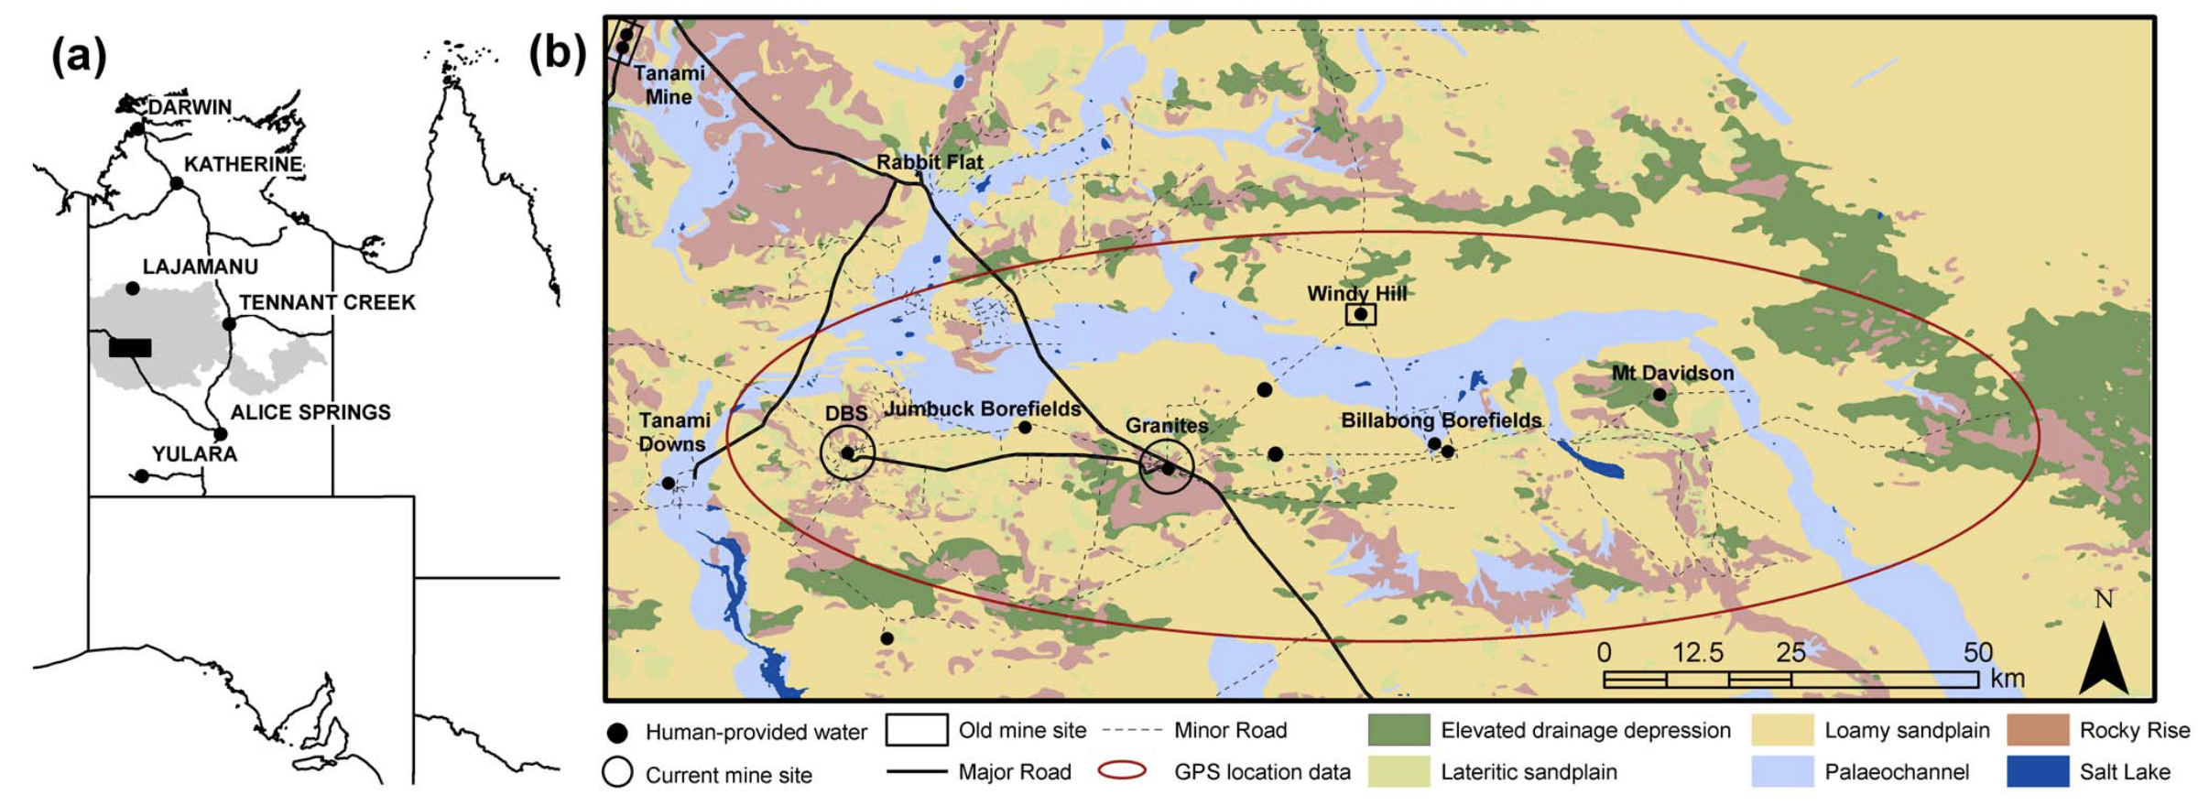
Dingo GPS data collection
From Newsome et al. (2013)

Slide 11
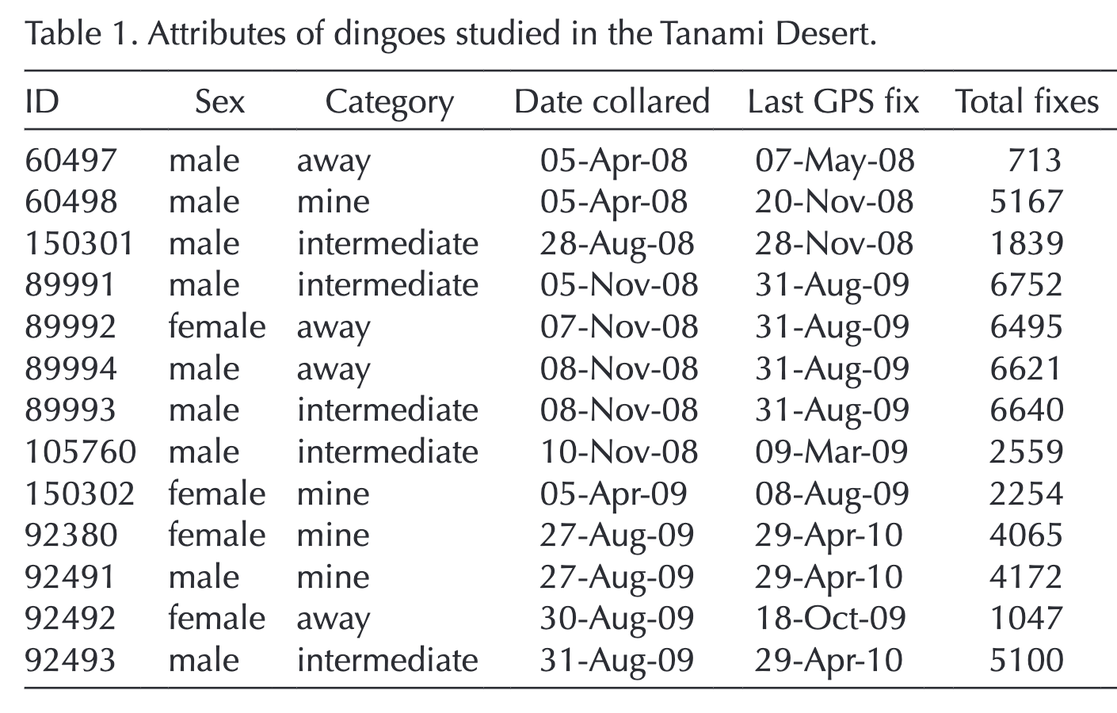
Dingo GPS data collection
13 dingoes
Hourly GPS data
3 – 9 months

Slide 12
Data cleaning
Spatial data has errors
Depends on the technology of the device (GPS, Argos, geolocator)
there are diagnostic metrics (HDOP, number of satellites)
Terrestrial
removing errors using using diagnostic metrics
behavioural filters (impossible, unlikely speeds)
Marine / ARGOS data
state-space modelling (aniMotum)
Dingo data cleaning

Slide 13
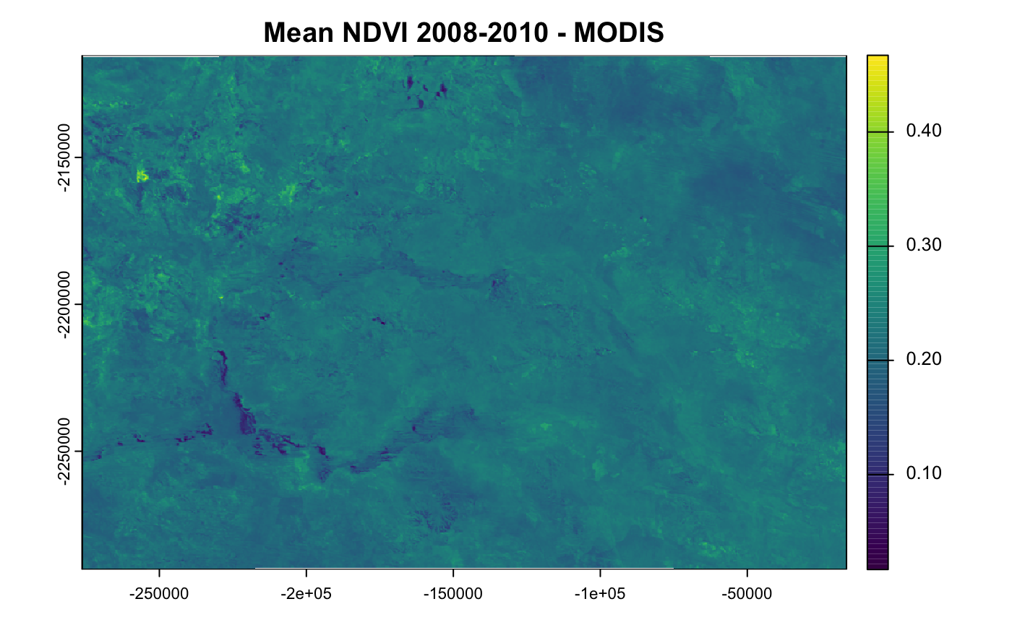
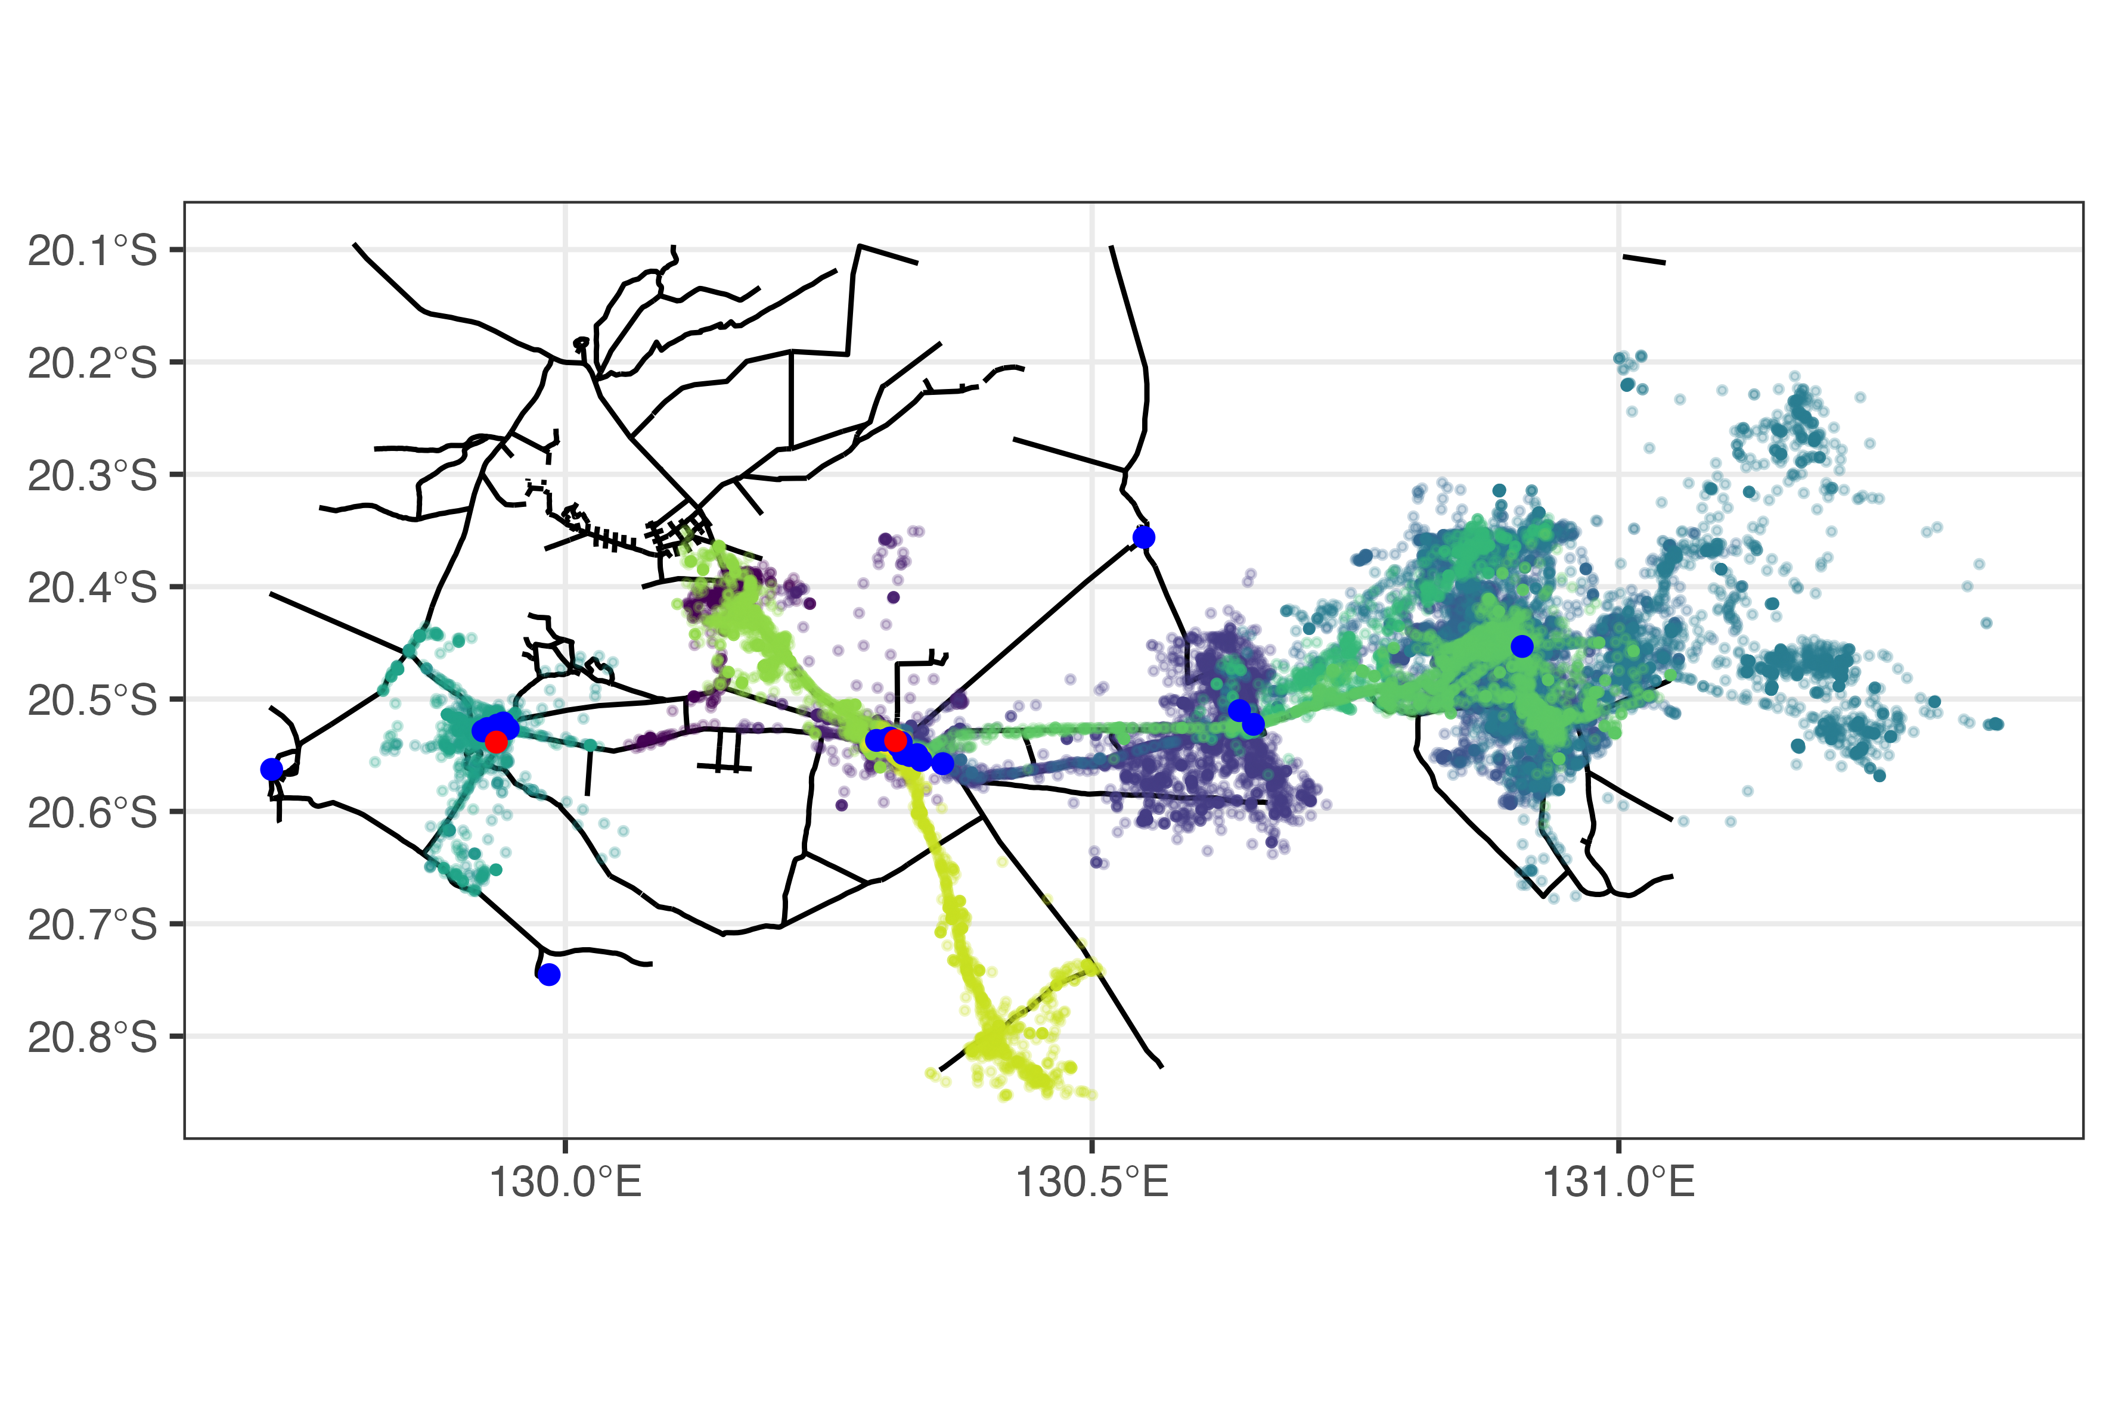
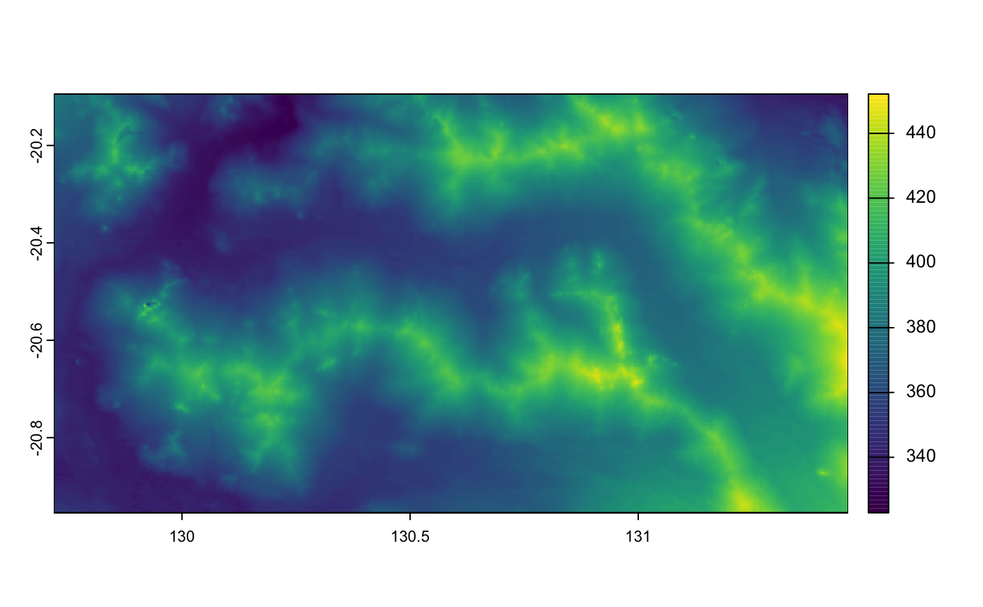
Spatial layers
other possible spatial layers
vegetation classes
terrain/soil classes
climate/weather
temperature
rainfall
NDVI
roads
artificial food locations
artificial water locations
elevation

Slide 14
Previous research with this dataset
Newsome, T. M., Ballard, G.-A., Dickman, C. R., Fleming, P. J. S., & van de Ven, R. (2013). Home range, activity and sociality of a top predator, the dingo: a test of the Resource Dispersion Hypothesis. Ecography, 36(8), 914–925. https://doi.org/10.1111/j.1600-0587.2013.00056.x
Newsome, T. M., Ballard, G.-A., Dickman, C. R., Fleming, P. J. S., & Howden, C. (2013). Anthropogenic resource subsidies determine space use by Australian arid zone dingoes: an improved resource selection modelling approach. PloS One, 8(5), e63931. https://doi.org/10.1371/journal.pone.0063931

Slide 15
Home ranges, activity and sociality

Slide 16
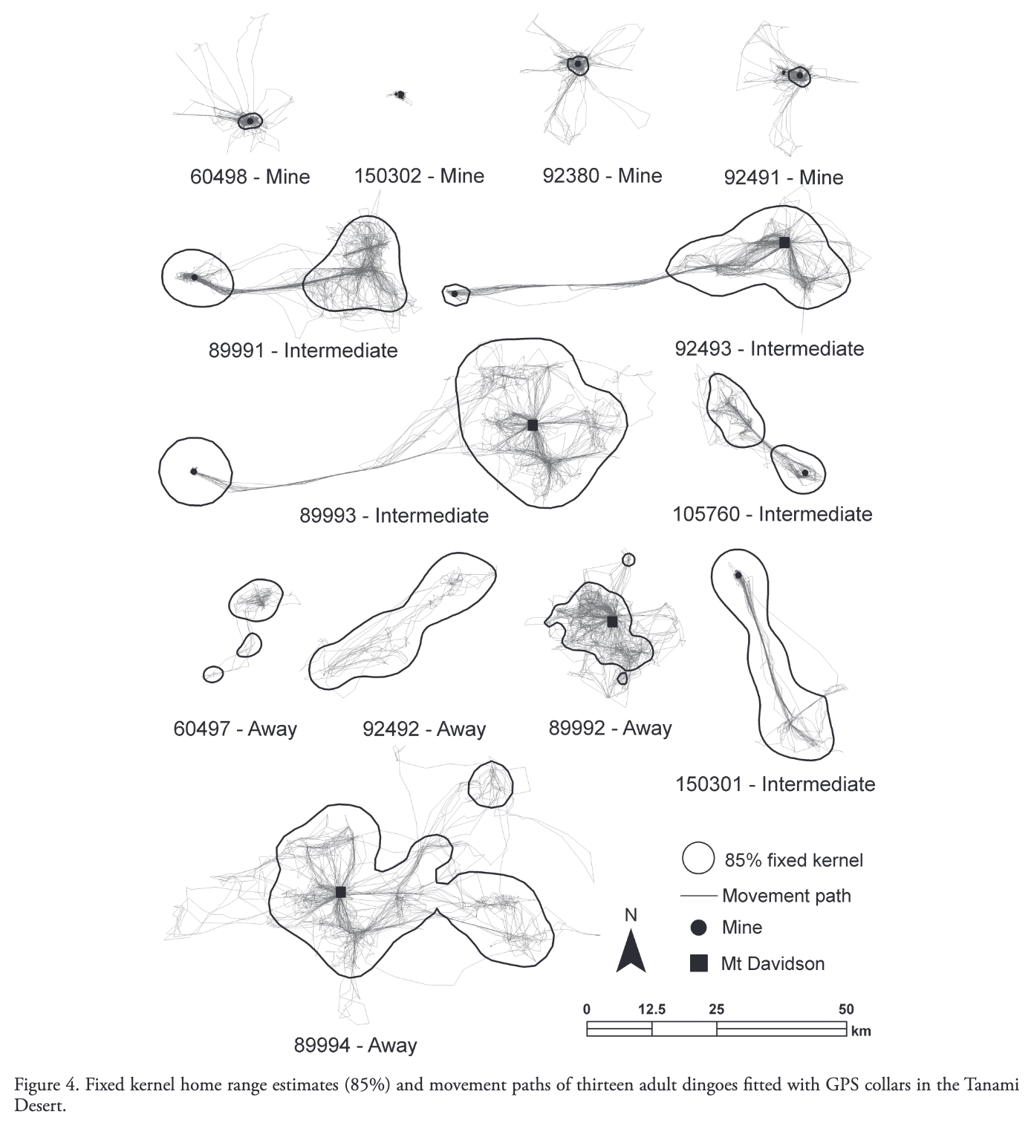
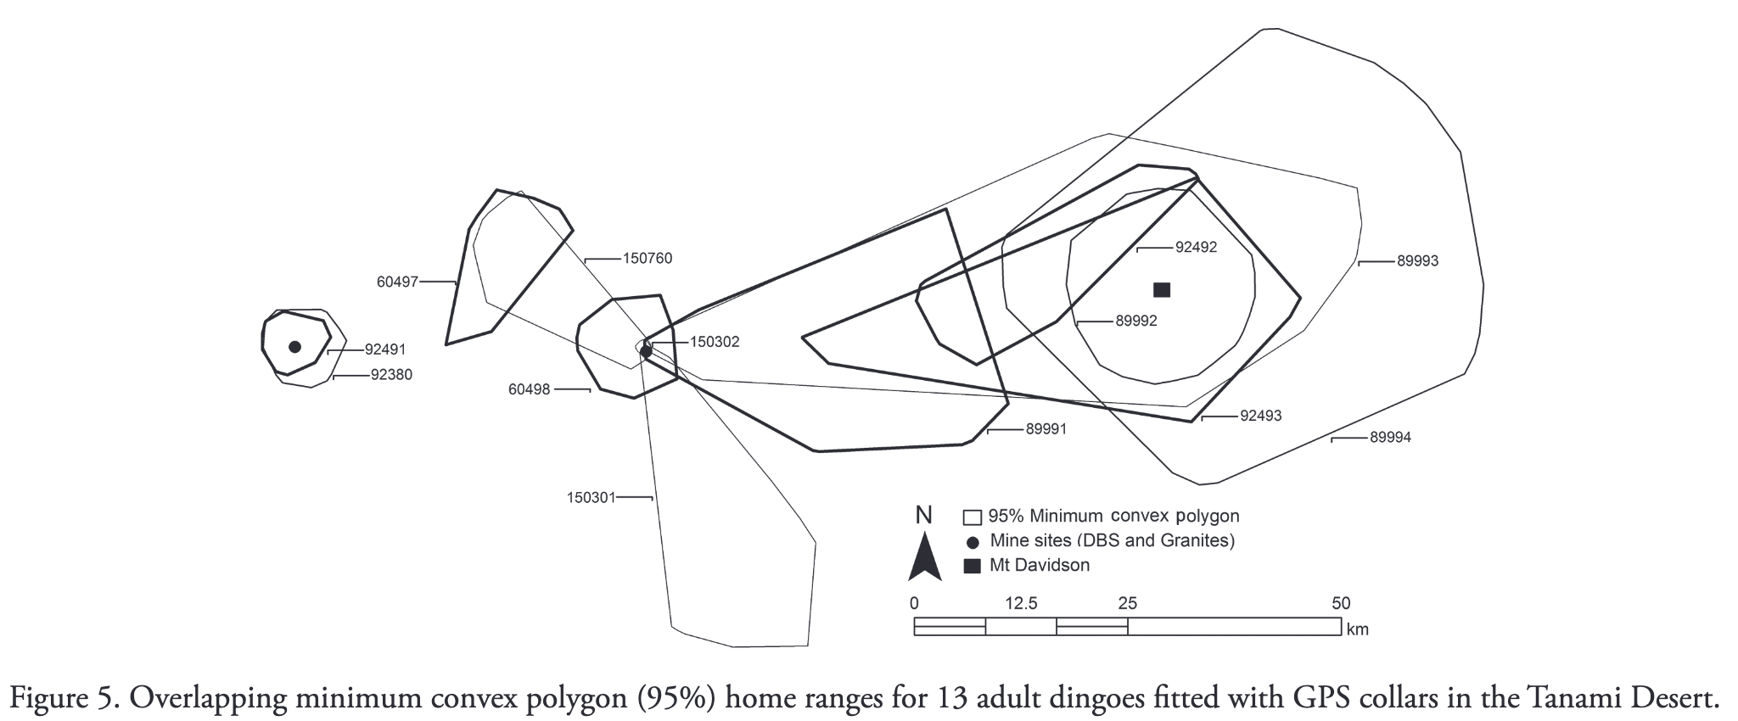
home range estimates
home range overlap

Slide 17
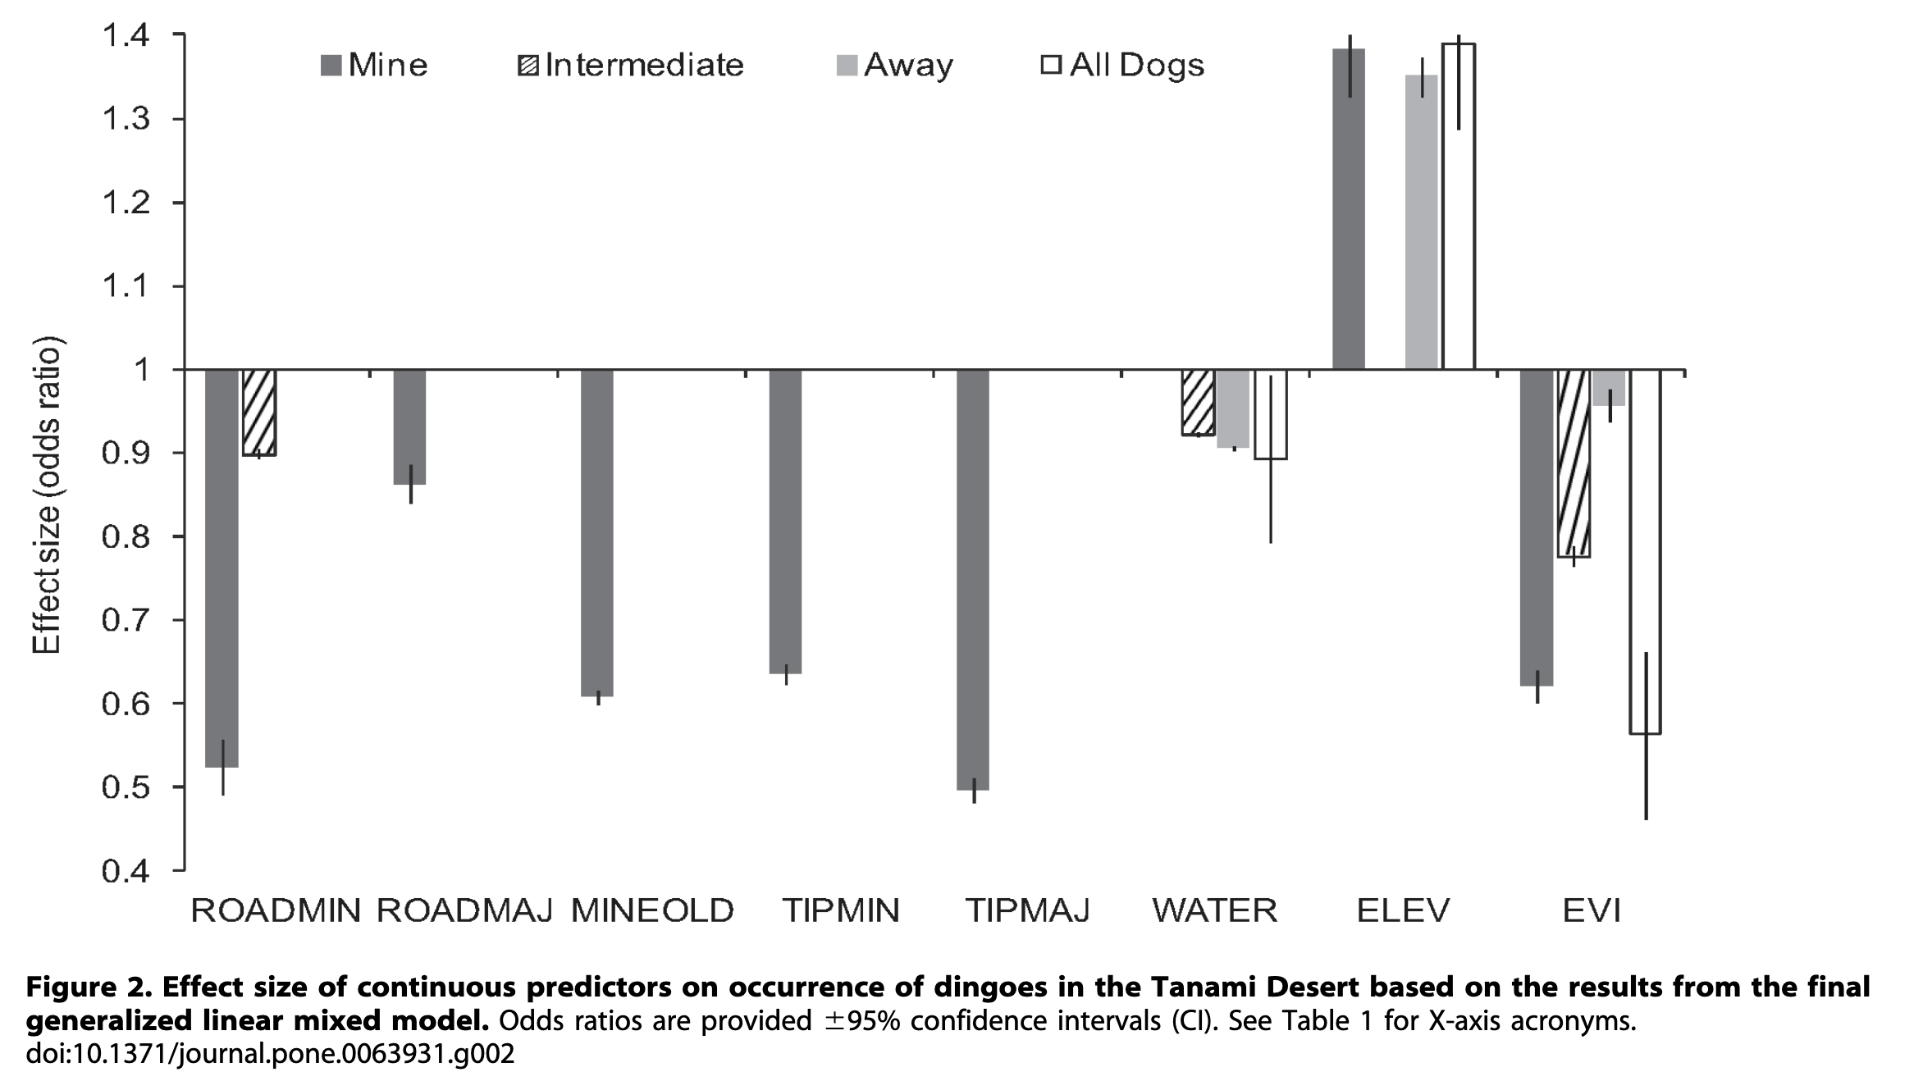
Resource selection modelling

Slide 18
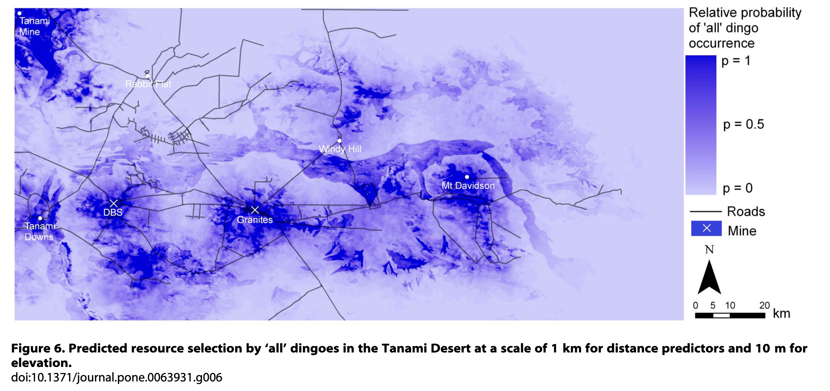

Slide 19
Brainstorm!
What are some research questions you can think of?

Slide 20
Some possible research questions
How do dingo behaviours differ between individuals at mine sites and those elsewhere?
What is the influence of the surrounding environment on the dingoes' movement?
How do dingoes’ behaviours change across the day?
How do dingoes connect through the landscape?
Do dingoes near mines have a higher probability of disease transmission?

Slide 21
Morning tea
At the end of the break
find a group
define your ecological question

Slide 22
Thinking through the problem
What is the question?
What is the quantity that you need to address your research question?
What data do you need?
is the dingo data appropriate?
What will you be comparing/analysing?
what is the time-scale?
what covariates might you need?

Slide 23
Movement ecology approaches
Movement summaries
Home range analyses (KDE, AKDE)
Behavioural classification (HMM, BCPA)
Resource and step selection functions (RSF, SSF)
Revisitation analysis
Social network analysis

Slide 24
Movement summaries
E.g., did the animal show different movement behaviour in different areas, times?
movement speeds, directionality
May be exploratory or used for inference
Can be used to guide model development

Slide 25
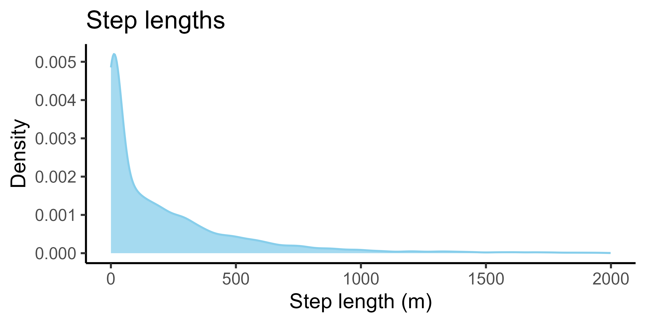
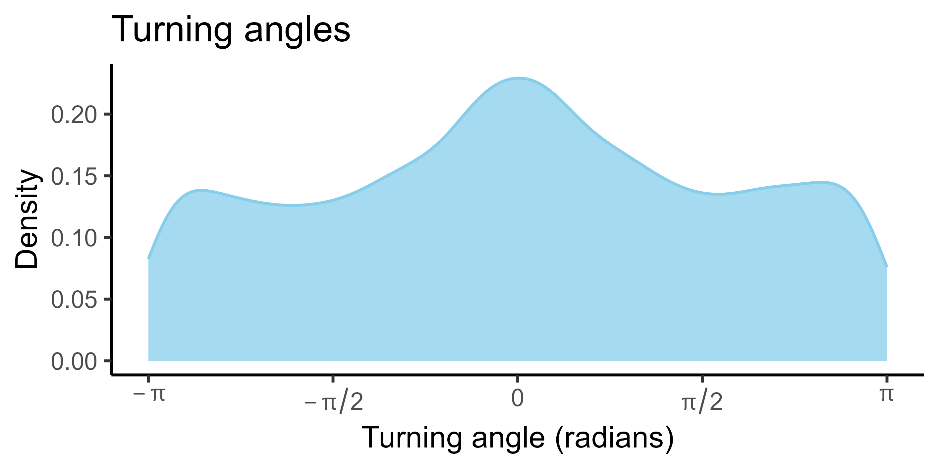
Movement data as ‘steps’
turning angle
θ
step length
θ
sl
sl
starting location

Slide 26
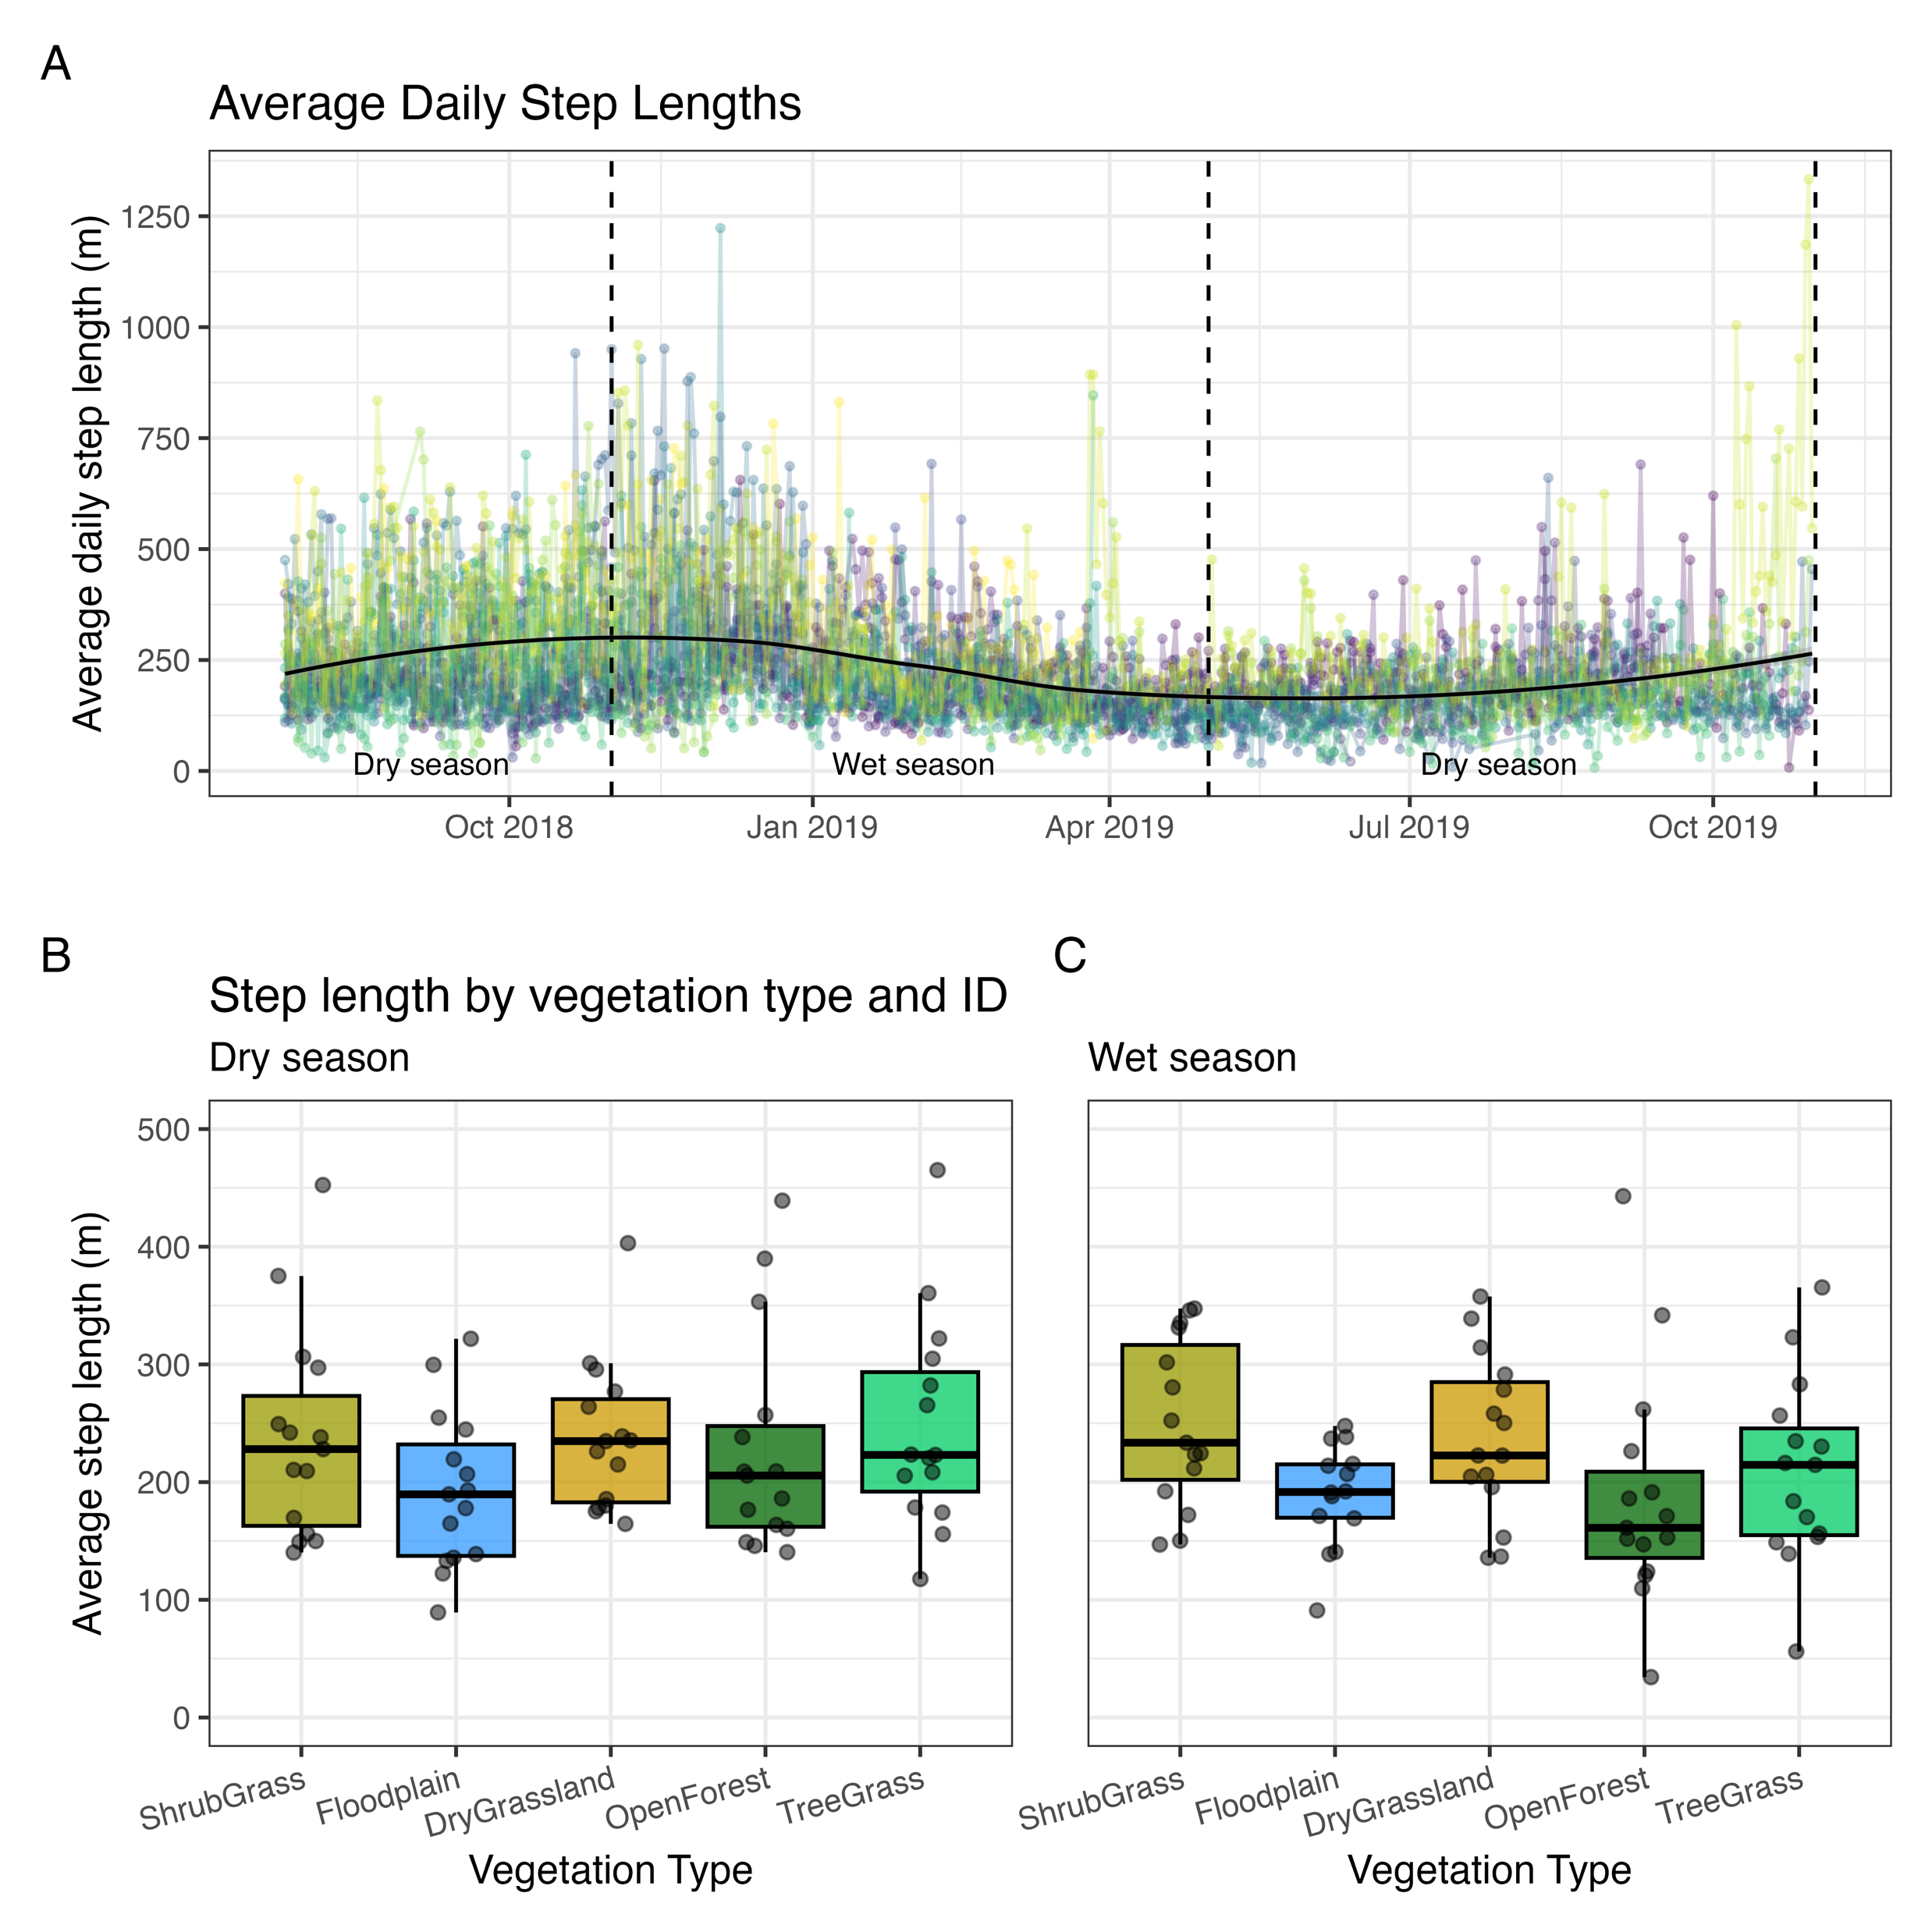
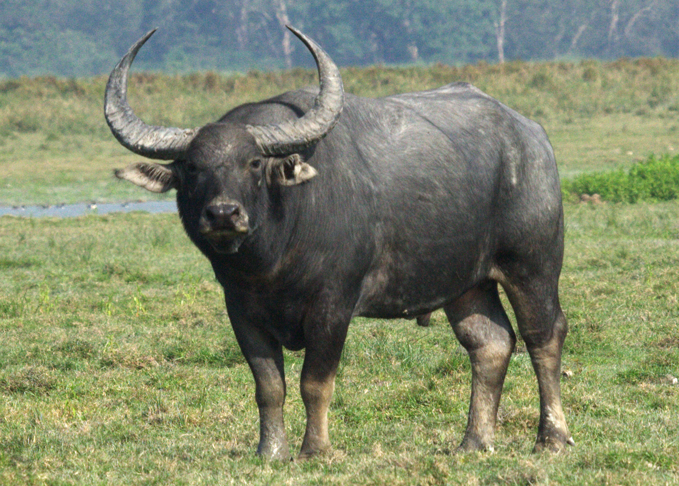
water buffalo
(Bubalus bubalis)

Slide 27
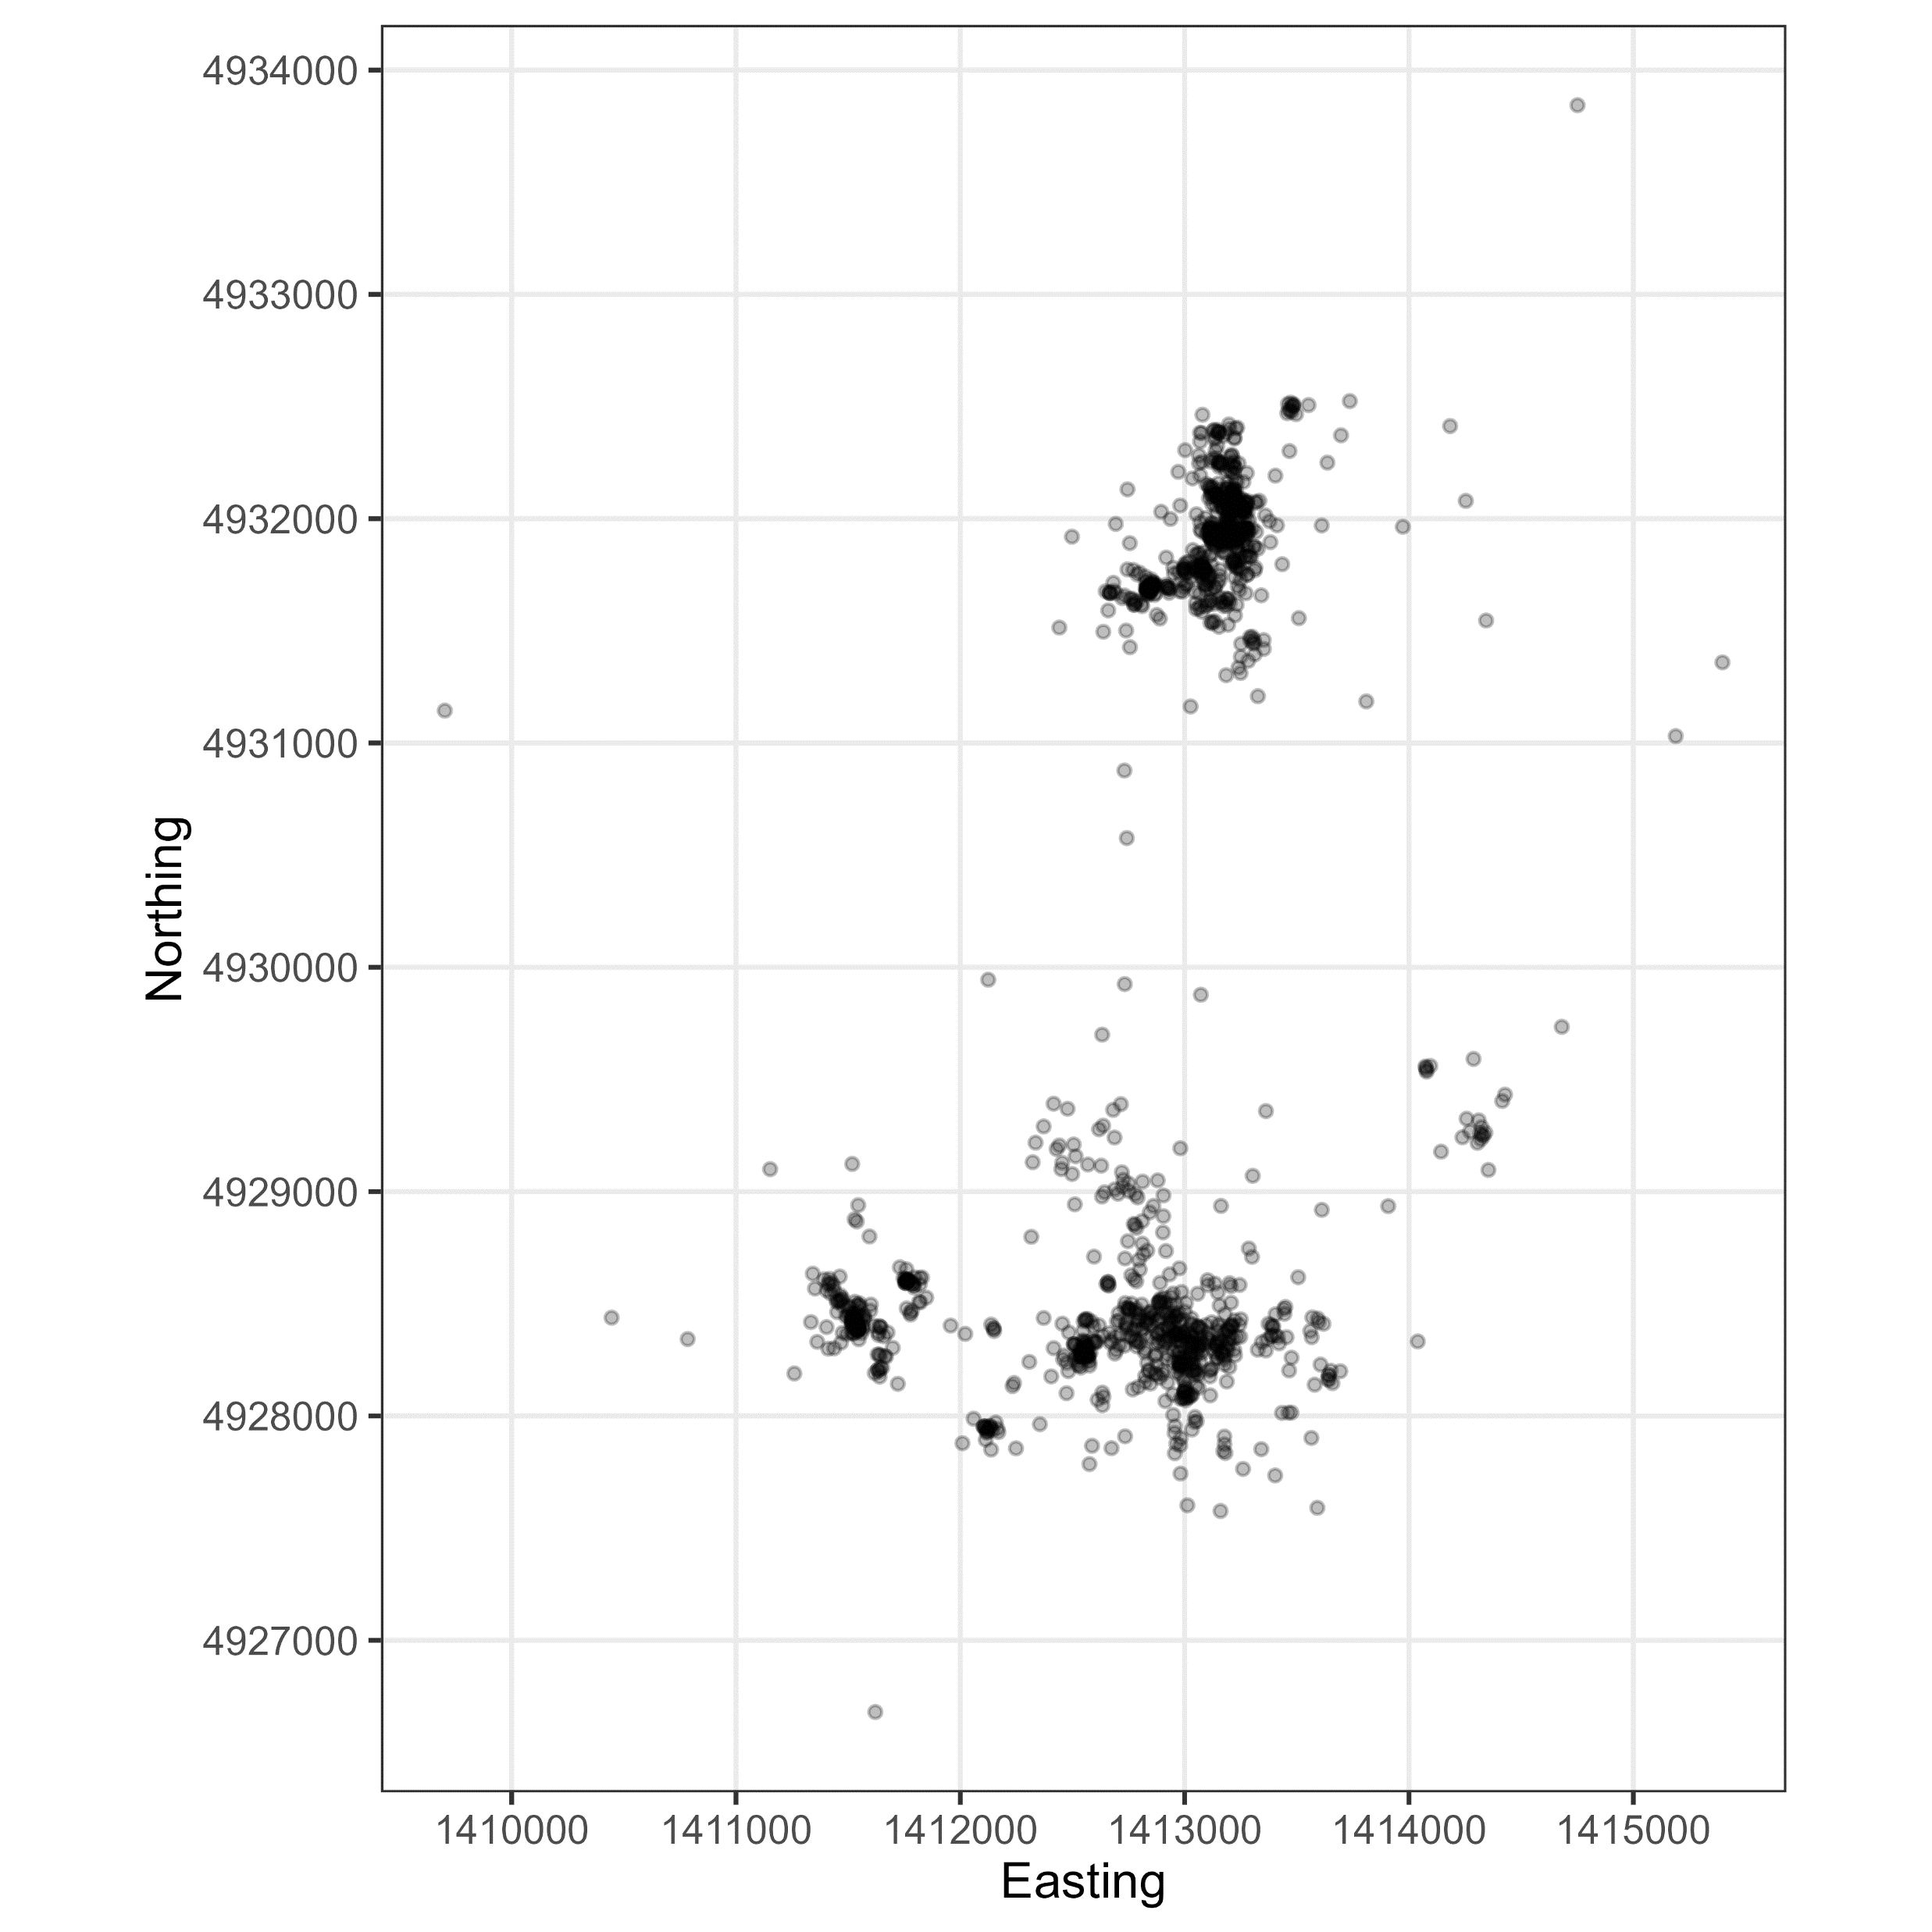
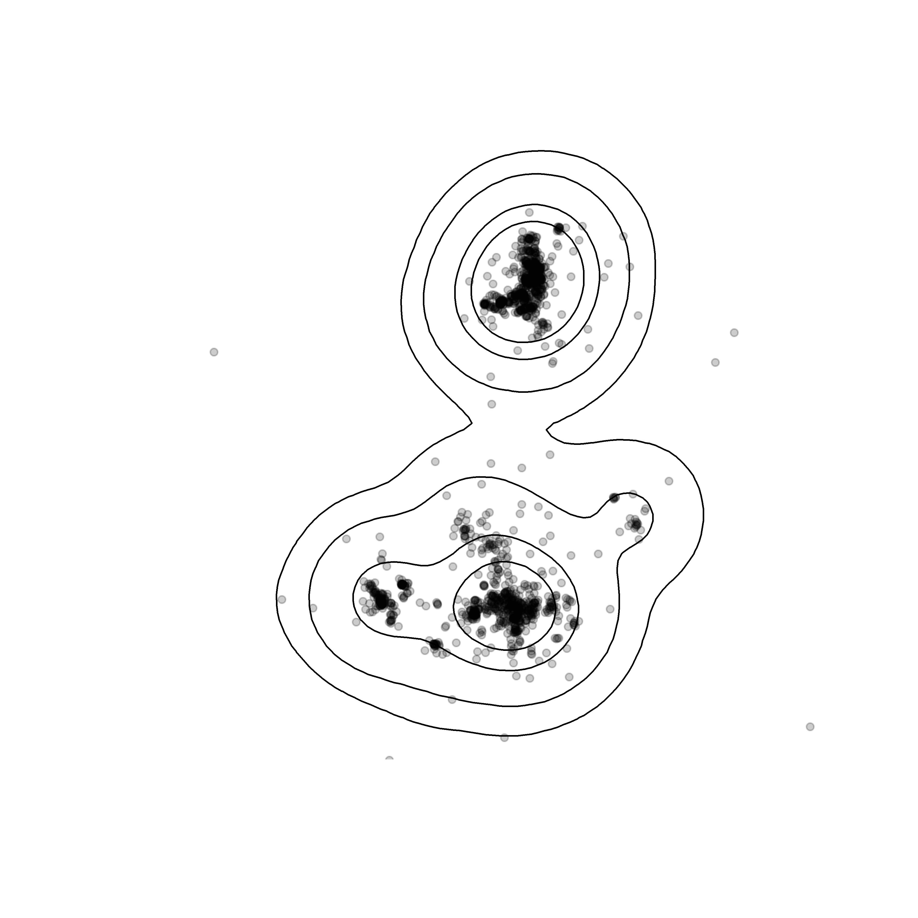
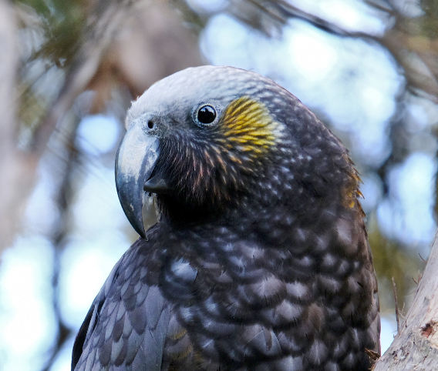
Home range analysis
What is the animal’s ‘home range’ or space use?
GPS locations
Kākā
(Nestor meridionalis)
Tag ID: 45505

Slide 28
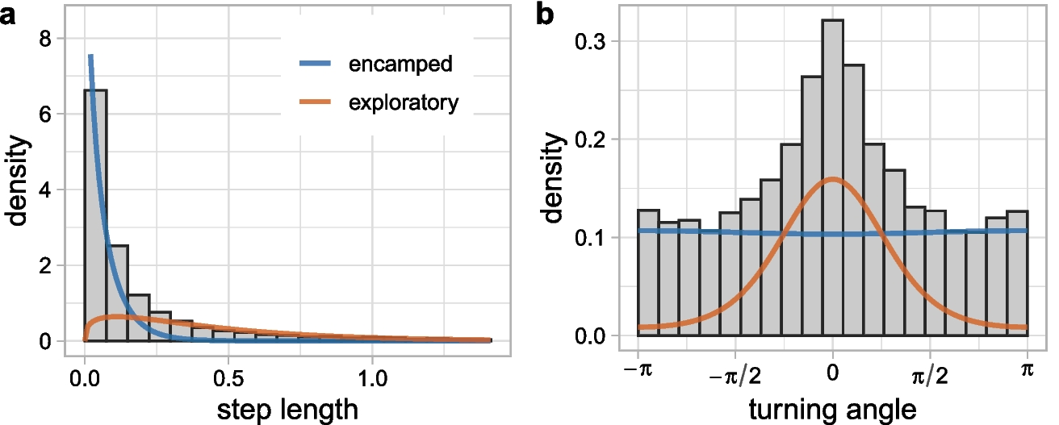
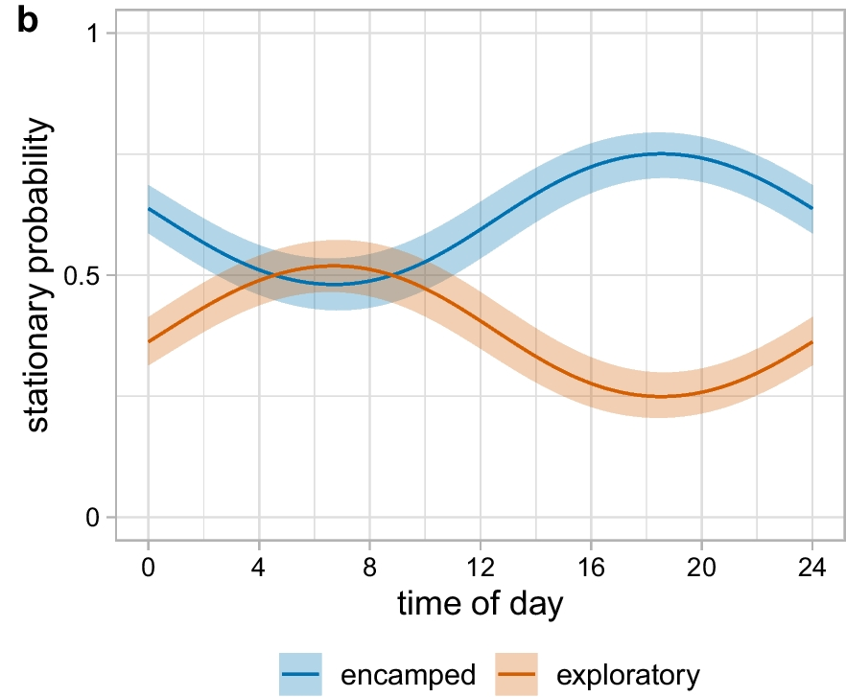
Behavioural classification
Figures from Klappstein et. al (2023)
What behaviours was the animal displaying?
Does this relate to any covariates (time of day, spatial layers)?

Slide 29
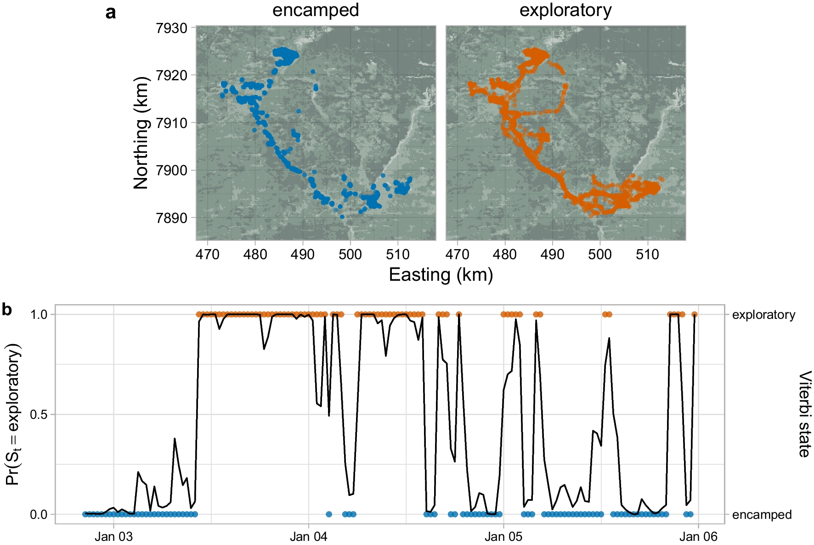
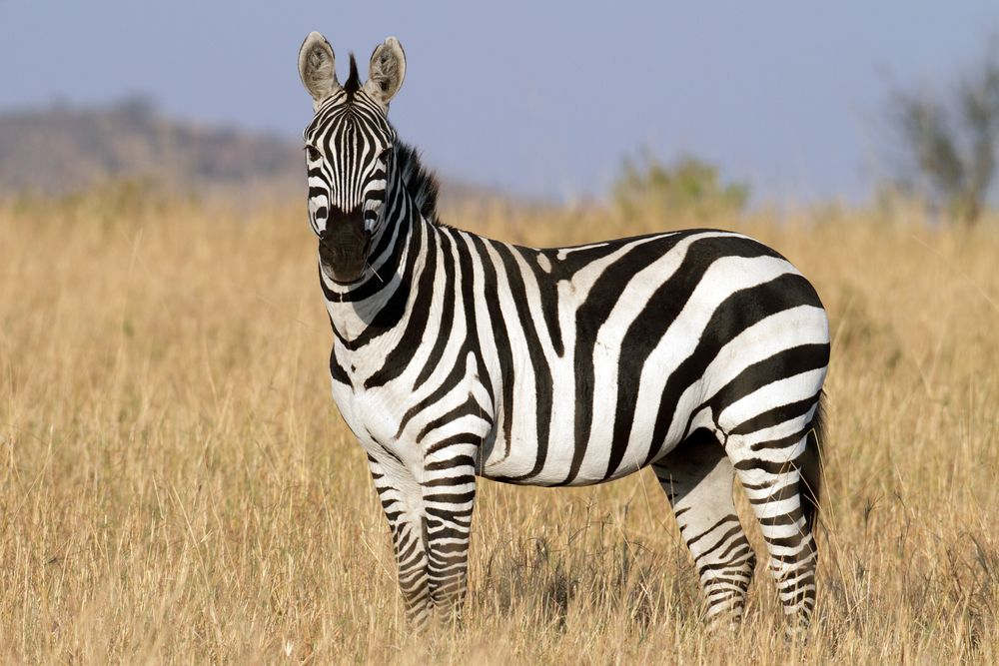
Figures from Klappstein et. al (2023)
behavioural state of each GPS location
Plains zebra
(Equus quagga)

Slide 30
Resource and step selection functions
What habitat was the animal using?
How was the habitat affecting its movement behaviour?

Slide 31
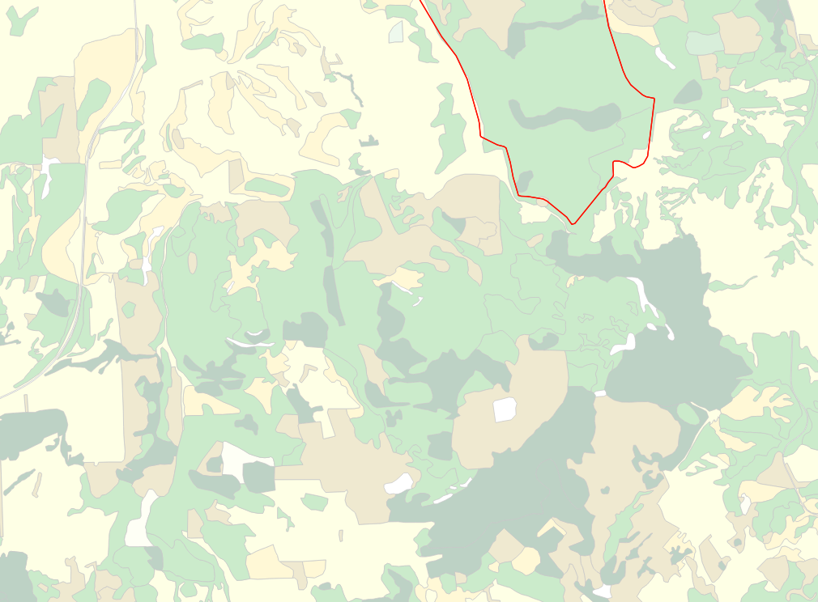

Step-selection functions
θ₁
sl₁
sl₂
θ₂
We take random ‘steps’ at each GPS location to sample the local availability, which become the 0s in our model
(Fortin 2005, Thurfjell 2014)

Slide 32
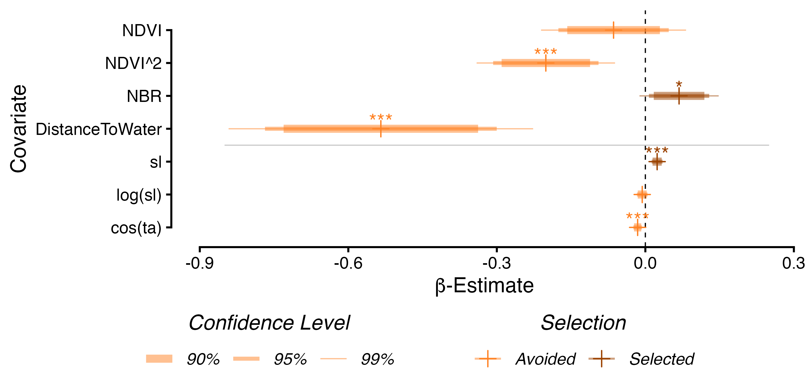
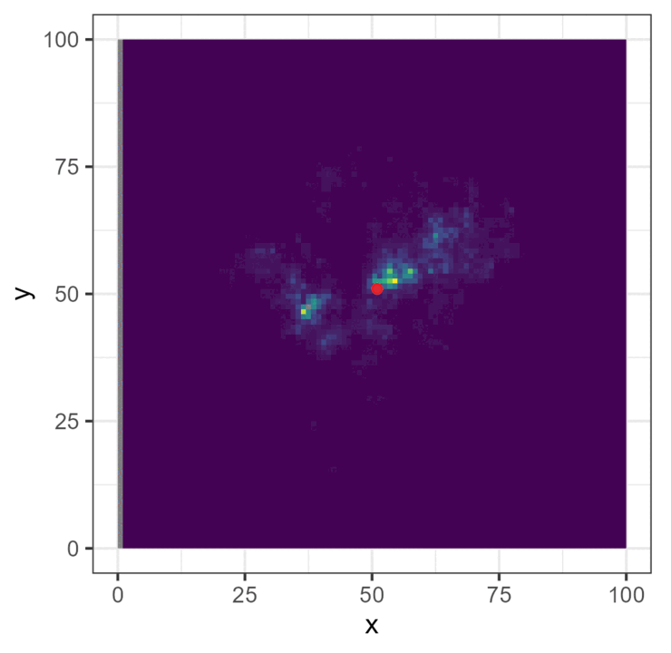
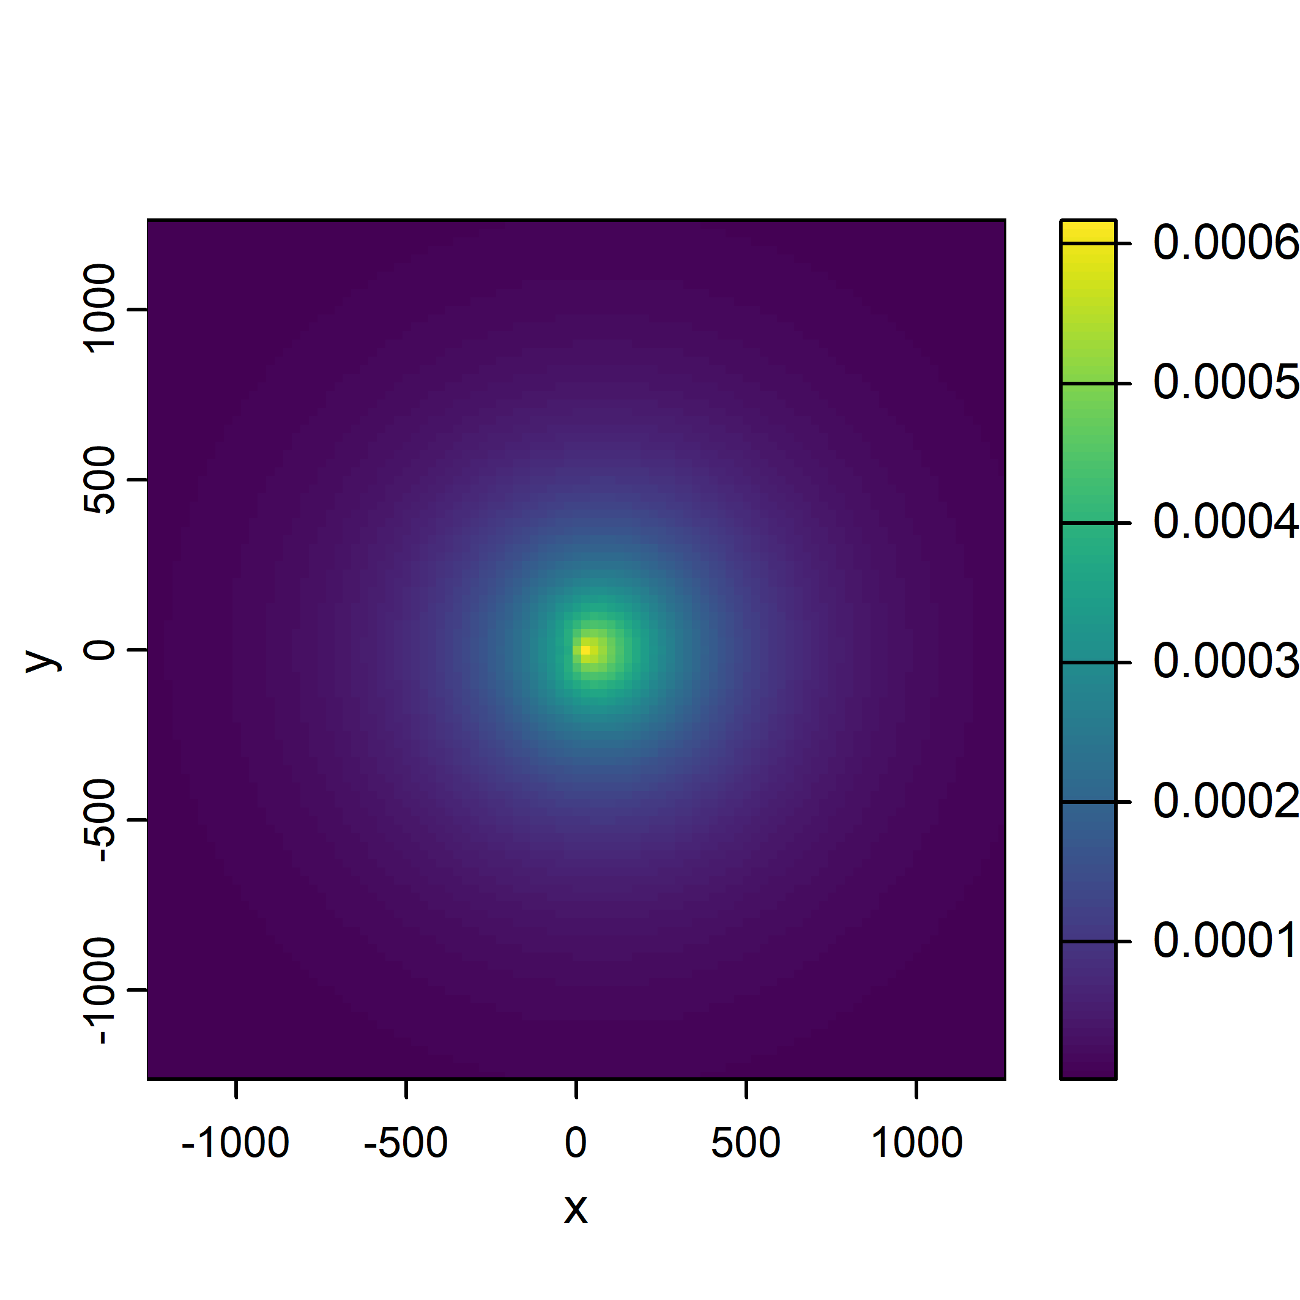
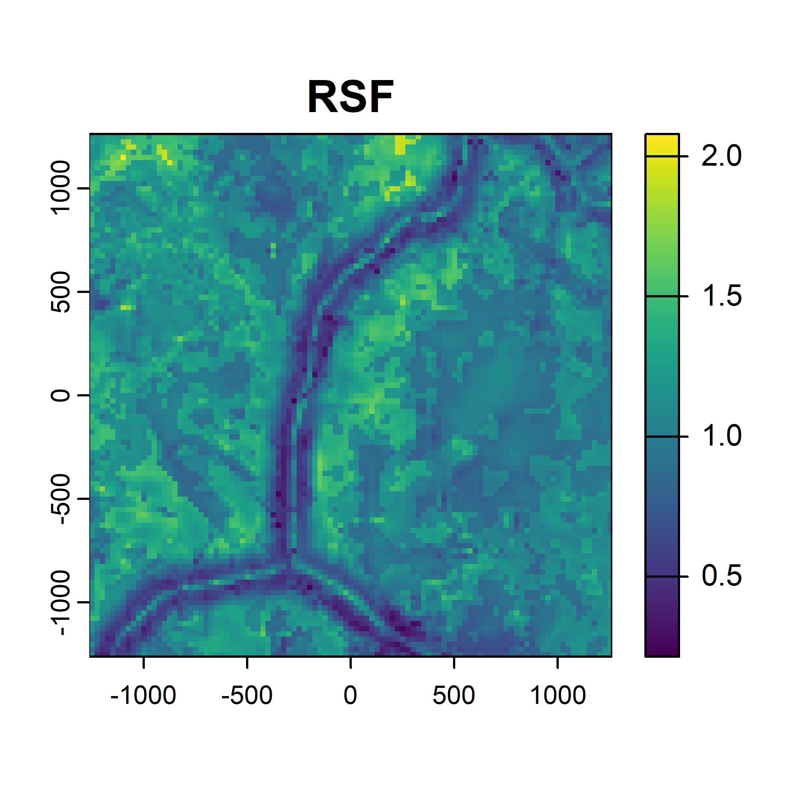
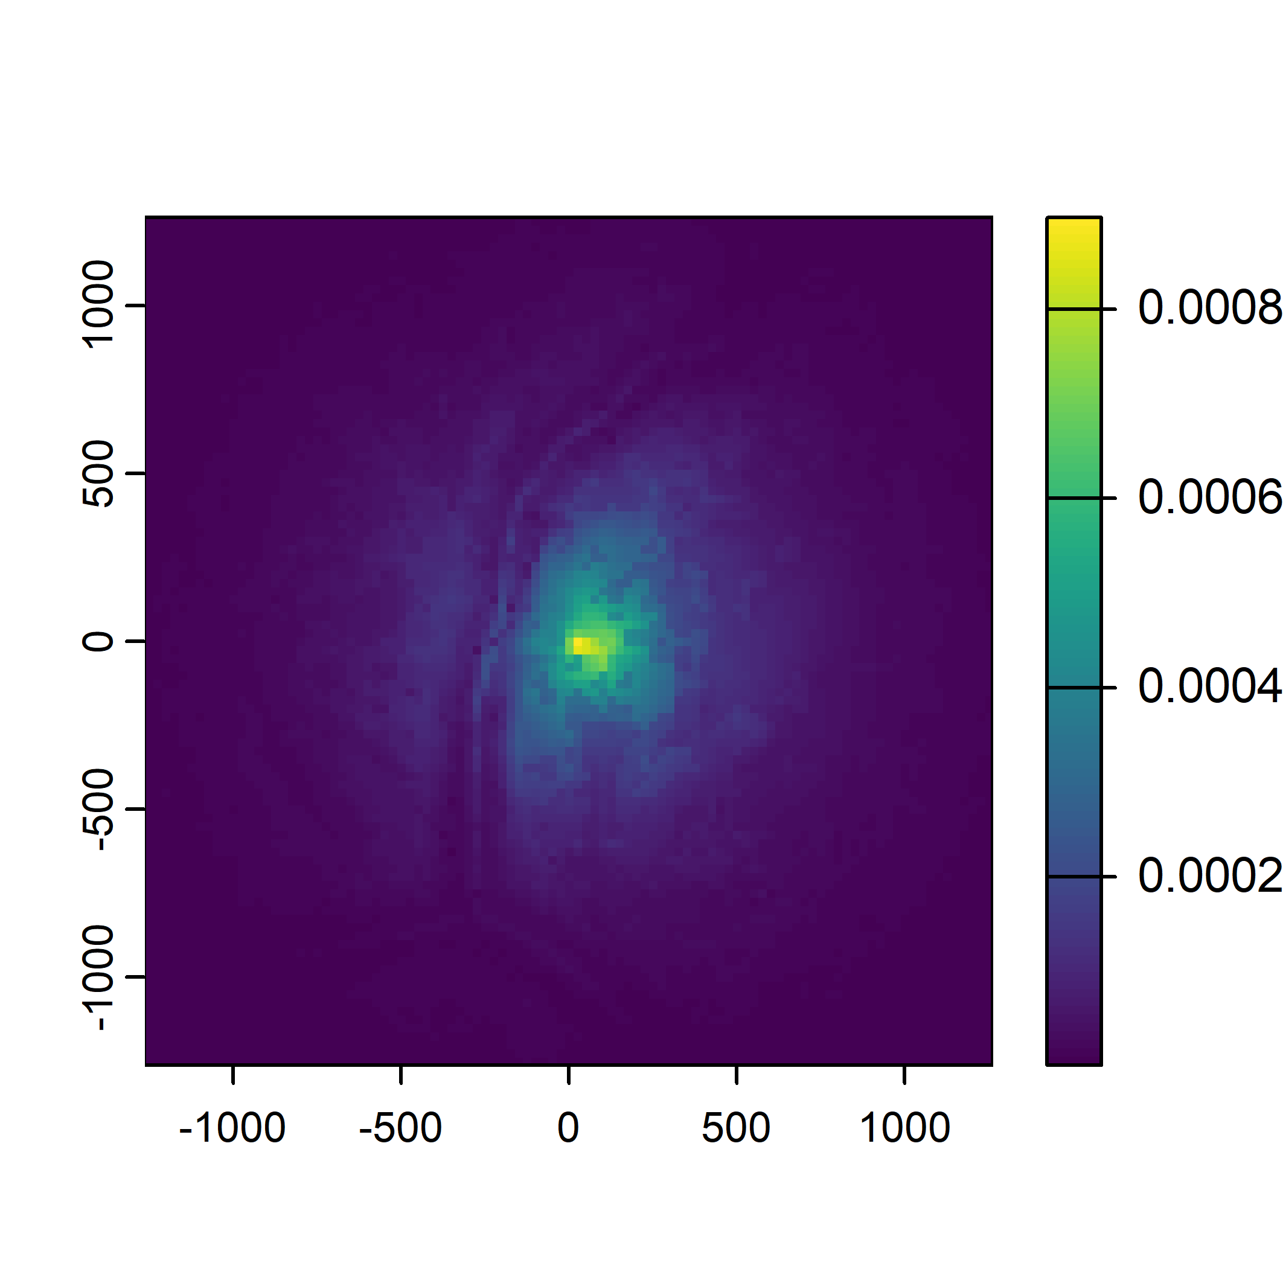
Resource and step selection functions
Movement
Habitat selection
Next step
A
B
C
Probability
Higher
Lower

Slide 33
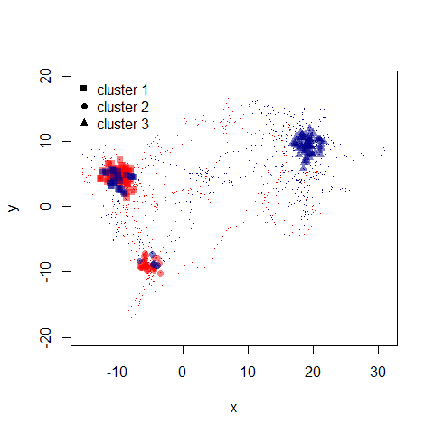
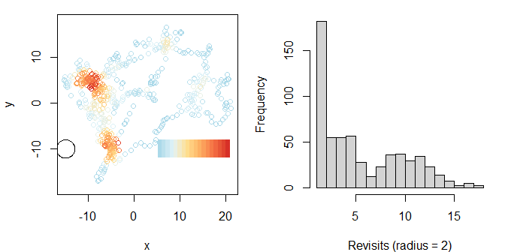
Revisitation analysis
clusters of locations to identify important areas
Where did the animal ‘revisit’?
Figures from: https://cran.r-project.org/web/packages/recurse/vignettes/recurse.html

Slide 34
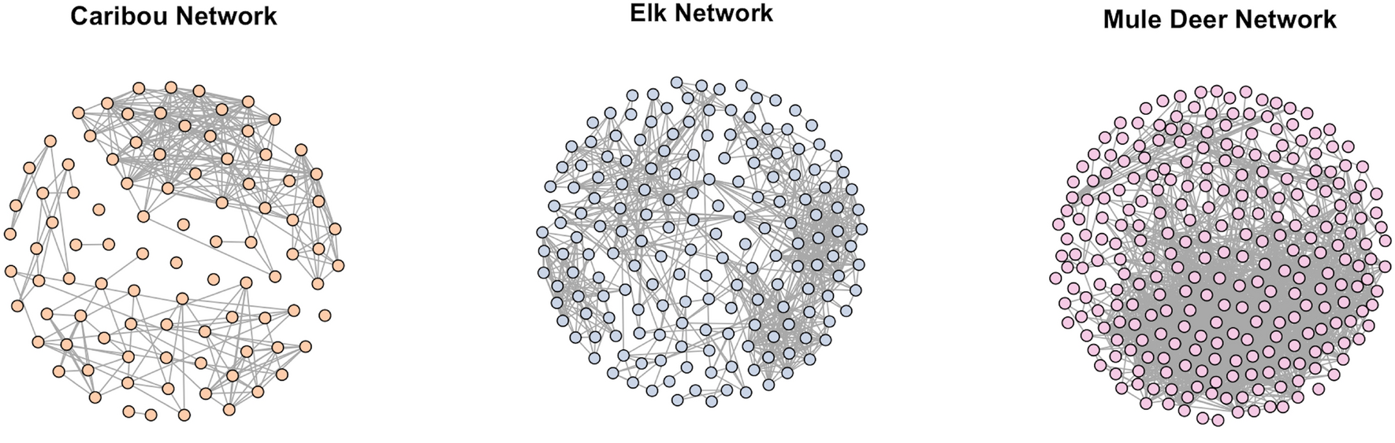
Social network analysis
Assessing connections between individuals based on proximity (in space and time)
Figure from Kaur et al. (2024)

Slide 35
Suggested workflow and delegation of tasks
Develop your research question
Determine what quantity you need to answer that question
Use the resources on the website, and look for packages, papers, tutorials online
Divide tasks
Looking for resources/tutorials
Getting data into appropriate format
Running analyses
Creating figures
Documenting methods
Feel free to move between groups if you want
Remember – not a competition – the aim is to learn!
Note on the use of generative AI – go for it but make sure you understand the code!
good for understanding general approaches and generating basic code
does not always capture specifics of animal movement

Slide 36
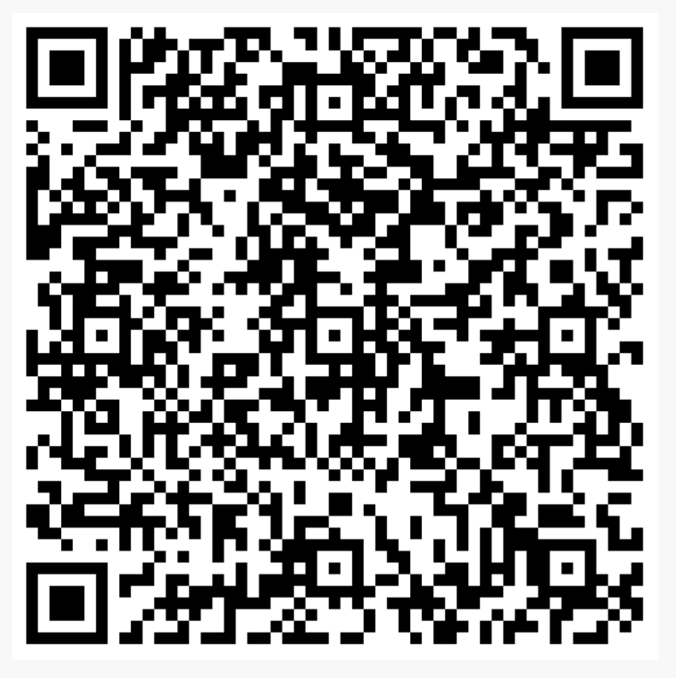
Collaborative journal article
EOI and feedback form
(fill out to be co-author)
How can we get the most out of movement datasets?
Showcasing outputs from each team
Outlining the process of the workshop
Everyone can be a co-author
Would require follow-up for tidying analyses, figures etc, and for putting the paper together

Slide 37

Looking forward
What workshops would you like to see in the future?
MoveSIN - https://movesin.github.io/website/
MoveSIN

